Slide 1
IOT-BOT FOR BOOK MANAGEMENT
Submitted by:
SOUVIK DATTA (19BEE1213)
MANGOLIK KUNDU (19BEE1101)
Embedded Systems Design (EEE 4020)
REVIEW - 3

Slide 2
OBJECTIVES OF THE PROJECT
Hostellers often forget to timely return the issued books back to the library. Moreover, due to their tight schedule, they get minimal time to physically go to library and submit the books.
To solve this issue and to ensure timely submission of the issued books, we aim to develop a project which solves these complexities.
Presenting our Robot, an autonomous robot with Barcode - QR Code scanning capabilities. The robot will mould the use of Computer Vision for ensuring safe collection and identification of books, all this while being powered by a Raspberry Pi for faster processing.

Slide 3
ABSTRACT OF THE PROJECT
Our robot will ensure the timely submission of issued books from the library and reduce the workload of the library. Moreover, it will also save the time and energy of students in the process.
It will be enabled with a barcode scanner to ensure the correct submission of books and will also have a QR code scanner which will scan an unique QR code provided to every student to verify the student. After submission it will store the submission information in database.
After the inventory of the robot gets filled up, the staff members can remotely drive the robot to the library to submit the books. To make the driving easier, the robot will be enabled with Ultrasonic sensors and real-time video tracking systems.

Slide 4
BLOCK DIAGRAM
Information of submission gets stored in database
Barcode Scan
Unique QR Code Scanner
Book Submission
Staff can drive the robots remotely back to library
After the inventory gets fill up

Slide 5
SOFTWARES USED
Raspbian OS
Proteus
Arduino IDE
Spyder

Slide 6
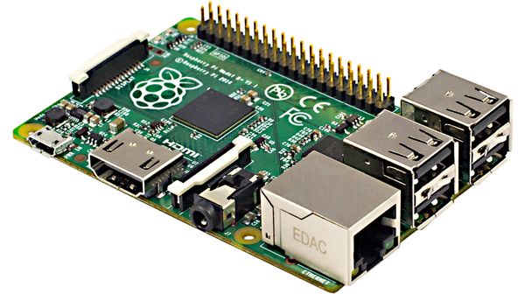
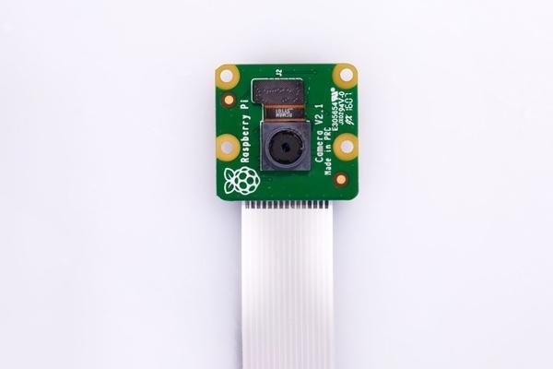
TECHNICAL SPECIFICATIONS / COMPONENTS USED
Raspberry Pi 4 for Processing
5 MP Pi Camera for enabling vision in the bot
Arduino UNO
HC-SR04 Ultrasonic Sensor
Servo Motor
NodeMCU ESP-8266 Wi-Fi Module
HX-771 Load Cell Amplifier Module
Load Cell
High Torque DC Motors
Chassis for Bot-Platform

Slide 7
EXPECTED OUTPUT
Our robot will ensure the timely submission of issued books from the library and reduce the workload of the library. Moreover, it will also save the time and energy of students in the process.
It will be enabled with a barcode scanner to ensure the correct submission of books and will also have a QR code scanner which will scan an unique QR code provided to every student to verify the student. After submission it will store the submission information in database.
After the inventory of the robot gets filled up, the staff members can remotely drive the robot to the library to submit the books. To make the driving easier, the robot will be enabled with Ultrasonic sensors and real-time video tracking systems.

Slide 8
References
1) Wireless remote control of a mobile robot by Nuri Almali
2) Nadvornik, J., & Smutny, P. (2014). Remote control robot using Android mobile device. Proceedings of the
2014 15th International Carpathian Control Conference (ICCC).
Published. https://doi.org/10.1109/carpathiancc.2014.6843630

Slide 9
IOT-BOT FOR BOOK MANAGEMENT
Submitted by:
SOUVIK DATTA (19BEE1213)
MANGOLIK KUNDU (19BEE1101)
Embedded Systems Design (EEE 4020)
REVIEW - 3

Slide 10
REVIEW – III
Book-Bot is a book collecting robot aimed at reducing library defaulters in the college campus.
The bot is programmed by a Raspberry Pi 4 and is interfaced with a lot of sensors for effective navigation through the campus.
The bot uses a Pi Camera for all it’s visual operations ie from Navigation to Book Verification.
The bot is capable of scanning QR Codes and Barcodes using the pyzbar library of Python.

Slide 11
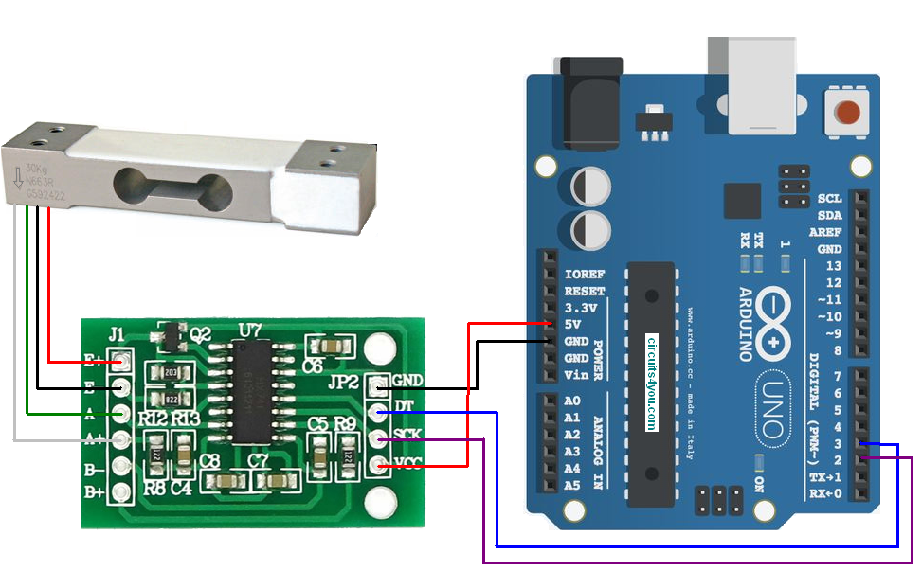
Mechanical Aspect -
HX-771 Load Sensor -
A load is applied to a strain gauge,
which causes the gauge to strain a
certain amount and output a voltage
proportional to the applied load.
This relationship between strain and
voltage is used in many applications
where weight measurement is
important. Load cells are very
common because of their linearity,
cost effectiveness, and their
ease of implementation.

Slide 12
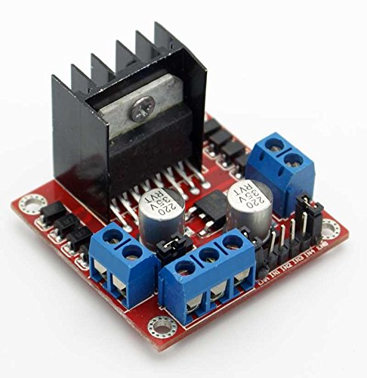
L298N Motor Driver -
Drive a 2-phase bipolar stepper
motor or two DC motors with the
L298 dual H-Bridge chip, mounted
on this handy breakout board
along with all necessary peripherals
It is ideal for robotic applications
and well suited for connection to
a microcontroller requiring just
a couple of control lines per motor

Slide 13
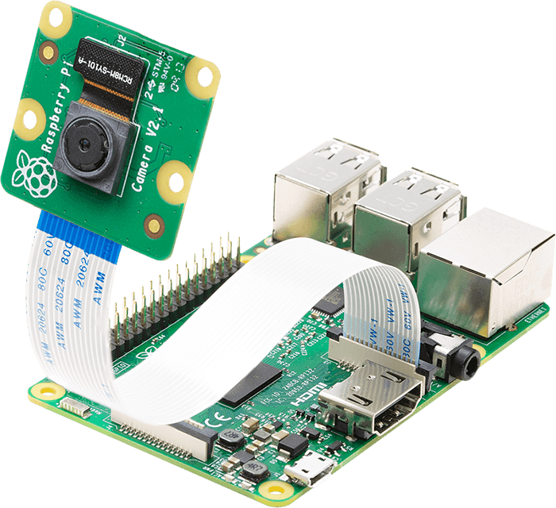
Raspberry Pi & Camera -
The Raspberry Pi is a tiny computer
about the size of a deck of cards.
It uses what's called a system on a
chip, which integrates the CPU and
GPU in a single integrated circuit,
with the RAM, USB ports, and other
components soldered onto the board
for an all-in-one package.
The Raspberry Pi Camera Board
plugs directly into the CSI
connector on the Raspberry Pi.
It's able to deliver a crystal
clear 5MP resolution image,
or 1080p HD video recording
at 30fps

Slide 14
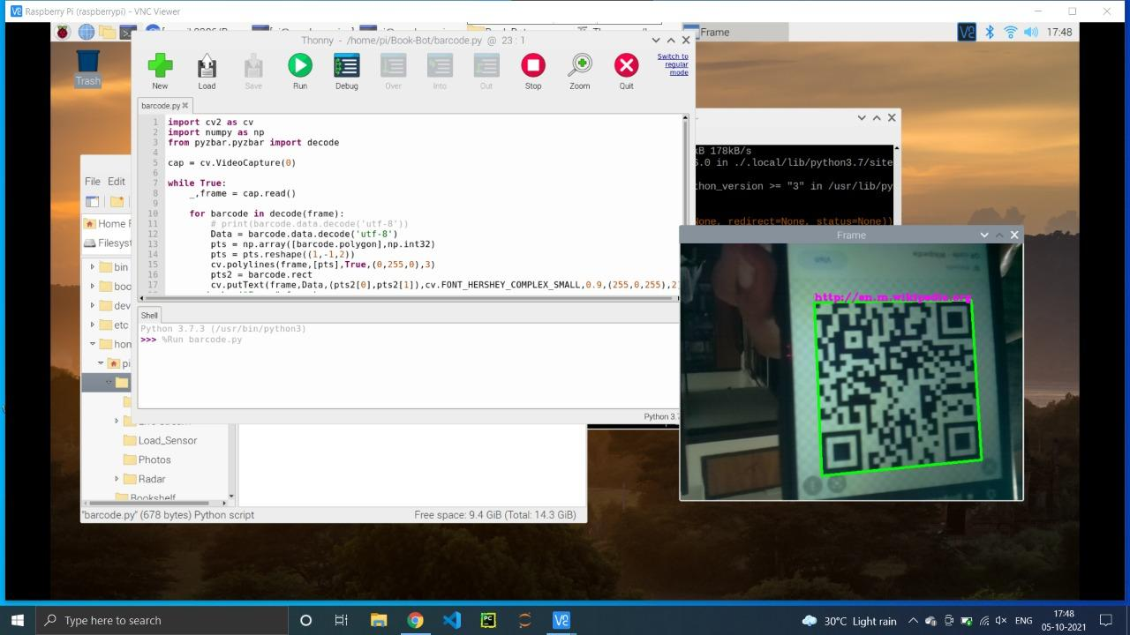

Slide 15
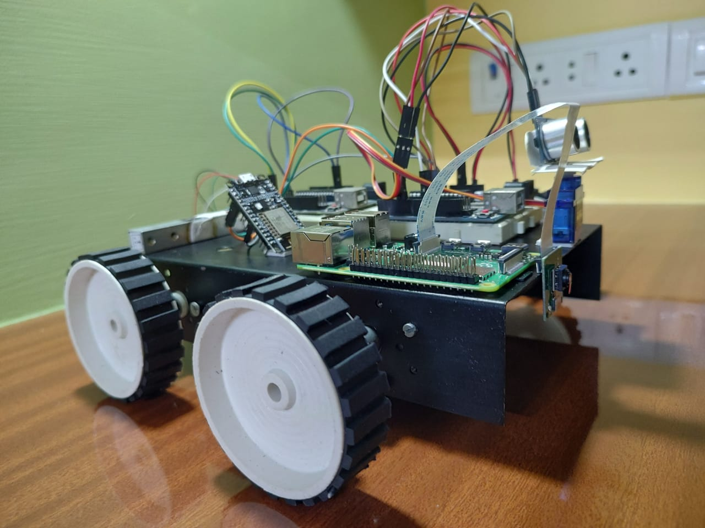

Slide 16
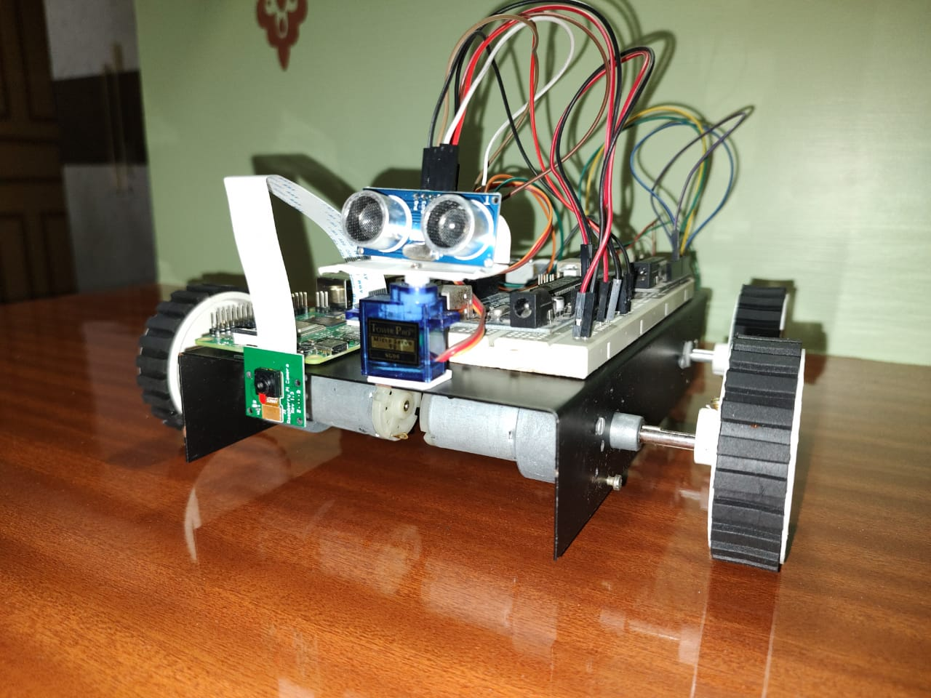

Slide 17
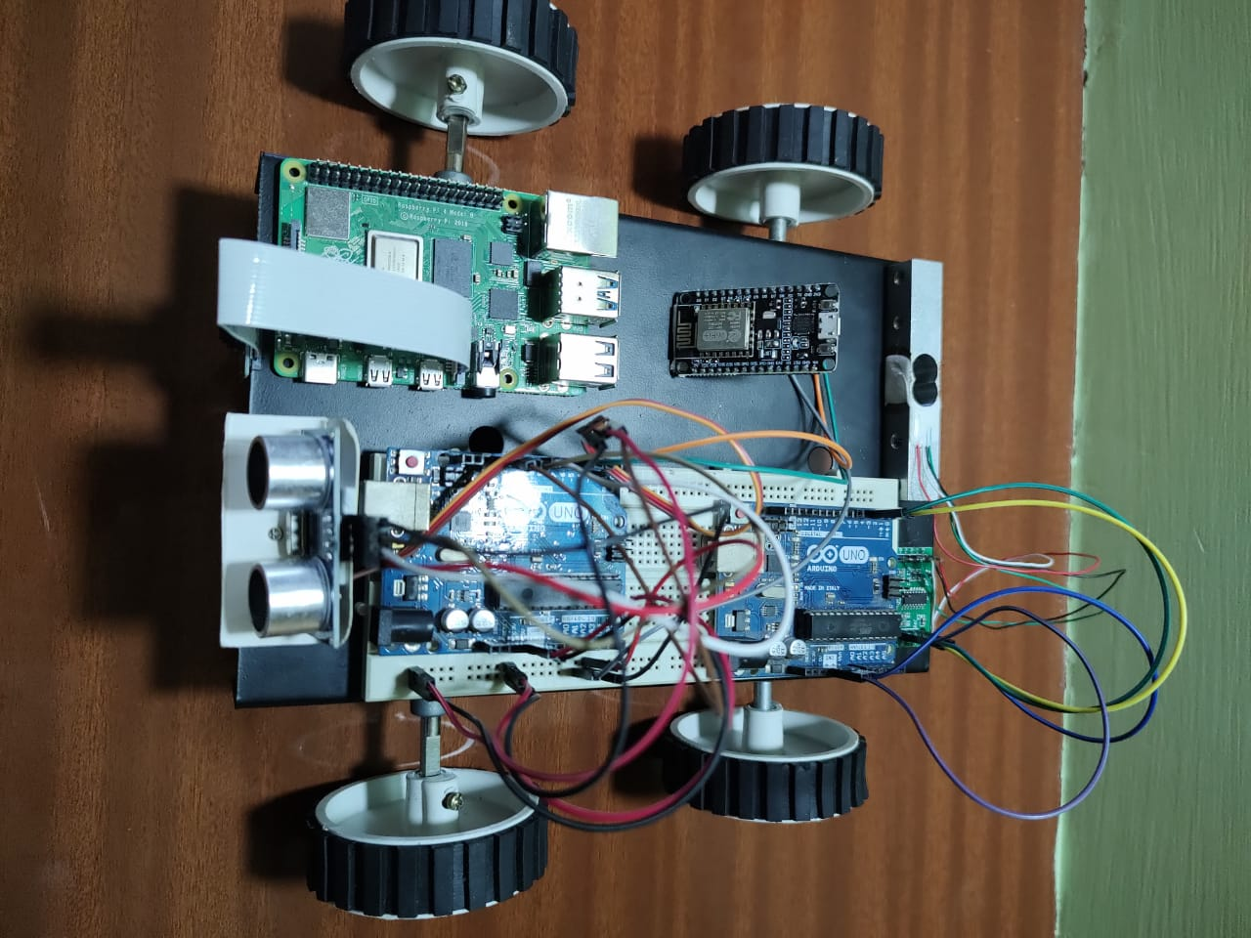

Slide 18
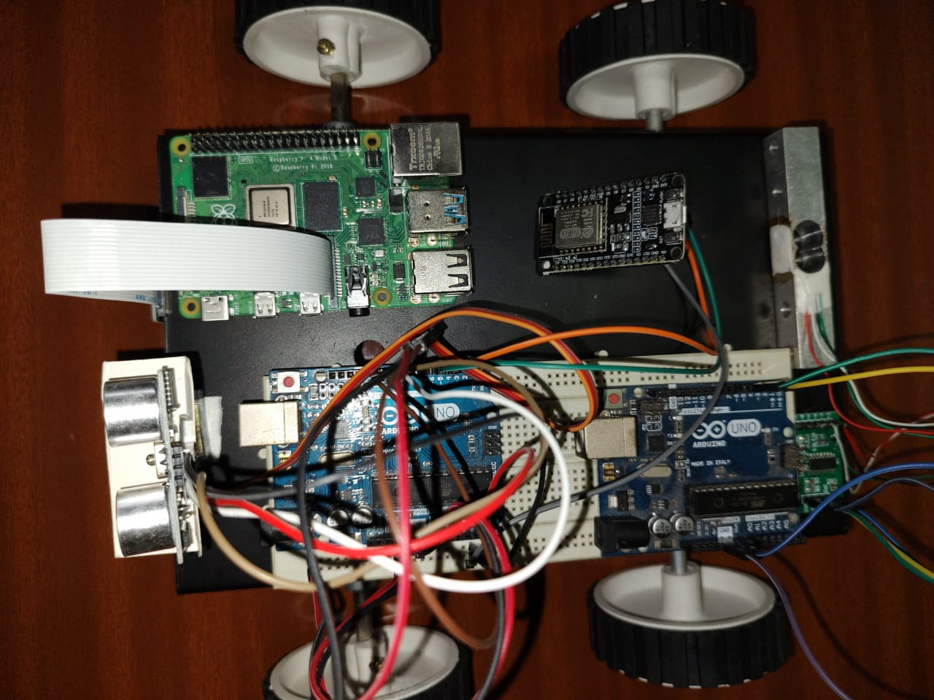

Slide 19
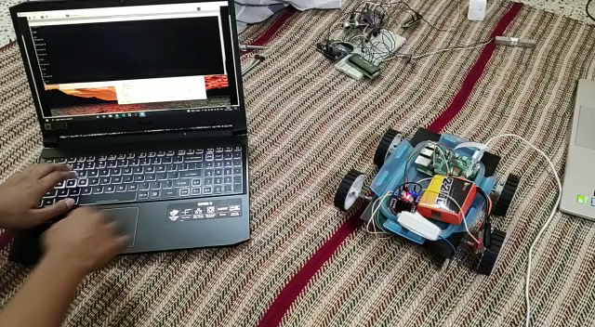
.
.

Slide 20




